Slide 1

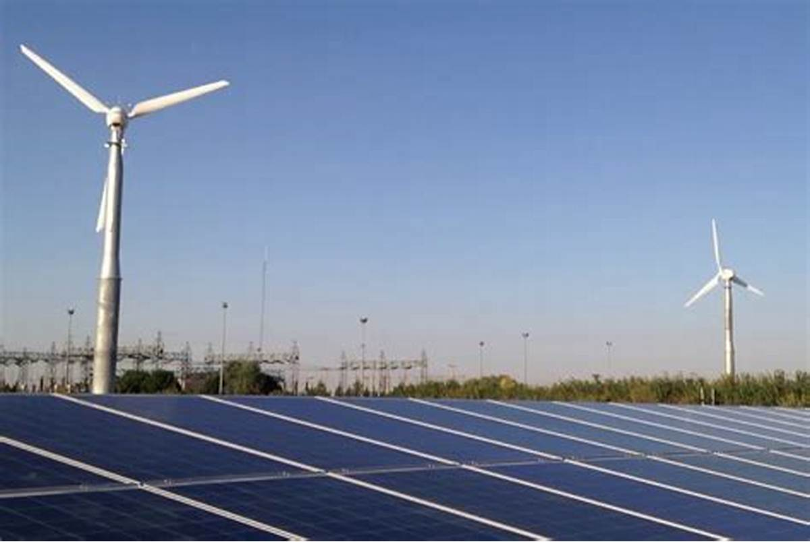
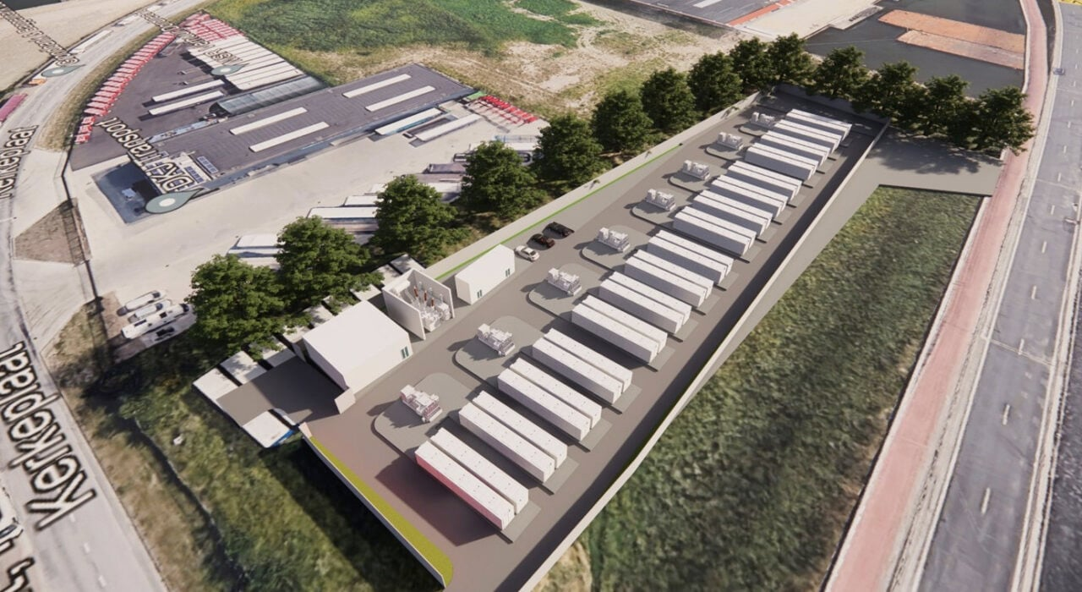
REVIEW OF
WIND/ HYBRID / BESS
PROJECTS
UNDER VARIOUS ISTS SCHEMES OF SECI
Solar Energy Corporation of India Limited
29.08.2025

Slide 2
CONTENTS
Introduction
Organogram of the division
Wind Scheme Progress & Projections
Wind Project Status
Hybrid Scheme at a Glance
Pending PPA Details
Hybrid Projects Status
Change in Law

Slide 3
INTRODUCTION
Key Activities Performed – Post Award of the Projects
PPA Signing, EMD release and PBG submission by RPDs
Monthly Progress Review - Conducting joint review meetings with Developers and Buying Utilities, discussions on the issues for the resolution and expediting the project progress.
Review of documents related to Financial closure as per PPA timelines
Review of Commissioning documents as per PPA provisions and issuance of commissioning / COD certificates.

Slide 4
Key Activities Performed – Post Award of the Project (contd…)
Release of PBGs after successful commissioning and LD implications, if any.
Review of extension requests raised by RE developers due to FM events / or any other reasons as per PPA / RFS provisions.
Handling legal cases for the petitions filed by RPDs and DRC matters appealed by RPDs
Handling Change in Law cases, reconciliation of CIL claims jointly with Discoms and CERC orders, final recommendations
Any other activity as required for the smooth implementation of the scheme

Slide 5
ORGANOGRAM
DGM (PS)
Anita Mohan Goel
BTech-Mechanical, MTech (Energy)
MGR
Aditee,
BE (Power Engg), MSc (Env)
MGR
Aalok,
BTech (EC)
Sr. Engr. Dileep
BTech Civil
MTech Structural
Director (Power System)
AGM (Projects)
Shreedhar Singh
Qualification
BSc Engineering
Sr. Engr.
Karishma
BTech - Electrical
Sr. Engr. Ashutosh
BTech Mechanical
Sr. Engr.
Ajay
BTech Mechanical

Slide 6
ORGANOGRAM – WIND SCHEME
Additional Charge:
1.Project Manager for SECI NDMC Project
2. Nodal point for applying connectivity in CTUIL for SECI Owned Project
DGM (PS)
(Anita)
Manager
(Ms Aditee)
Sr. Engineer (Mr Dileep)
Sr. Engineer (Mr Ashutosh)
PPA Signing, FC documents Review
All Legal Matters
Reviewing Petitions
Drafting replies in consultation with legal counsel
Additional Charge: Assisting DGM – PS for NDMC Project
Project Progress Review Meetings
Review Commissioning Documents
Review Extension Request
Preparation and updates of MIS
Review of Change in Law documents
Joint Reconciliation with Discoms
Finalisation of CIL claims
Additional Charge: Assisting DGM – PS for NDMC Project

Slide 7
ORGANOGRAM – Hybrid SCHEME
DGM (PS)
(Anita Mohan Goel)
Manager
(Mr Aalok)
Sr. Engineer
(Miss Karishma )
Sr. Engineer
(Mr Ajay)
Additional Charge:
1.Project Manager for SECI NDMC Project
2. Nodal point for applying connectivity in CTUIL for SECI Owned Project
Process Extension Request, BESS Project with KSEB
Additional Charge: Assisting DGM – PS for NDMC Project
Follow up with CTUIL regarding connectivity document submission
All Legal Matters- Drafting Replies
All Change in Law Matters
Review of documents, Joint Reconciliation with Discoms
Additional Charge: Review of SCADA Drawings as when required
PPA Signing, FC documents Review
Project Progress Review Meetings
Review Commissioning Documents
Preparation and updates of MIS

Slide 8
ISTS WIND POWER PROJECTS – YoY PROGRESS & PROJECTIONS

Slide 9
ISTS WIND POWER PROJECTS – TRANCHE-WISE PROGRESS
*In T-I, PPA was signed between WPD and PTC
** T-XV was cancelled due to abnormally high tariff quoted by bidders

Slide 10
ISTS WIND POWER PROJECTS – YoY PROGRESS & PROJECTIONS
Tranche | Total Capacity Tendered (MW) | Total capacity awarded (MW) | PPA Signed Capacity (MW) | PPA Effective Date | Original SCD | Capacity Commissioned till date (MW) | Capacity Under Implementation (MW) | Cancelled / Terminated (MW) | Disputed Capacity (MW) | Capacity not likely to come up (MW) | Tariff (INR/kWh)
I | 1000 | 1049.9 | 1049.9 | 21-07-2017 | 05-10-2018 | 999.9 | 0 | 50 | 0 | 0 | 3.46
II | 1000 | 1000 | 1000 | 02-01-2018 | 03-05-2019 | 760.1 | 0 | 239.9 | 0 | 0 | 2.64 - 2.65
III | 2000 | 2000 | 2000 | 24-05-2018 | 24-11-2019 | 950.2 | 0 | 0 | 1049.8 | 0 | 2.44 – 2.45
IV | 2000 | 2000 | 2000 | 30-08-2018 | 28-02-2020 | 721.9 | 0 | 573 | 705.1 | 0 | 2.51 – 2.52
V | 1200 | 1190 | 1190 | 22-01-2019 | 22-07-2020 | 621.5 | 0 | 393.5 | 175 | 0 | 2.76 – 2.77
VI | 1200 | 1200 | 1075 | 15-09-2019 | 15-03-2021 | 973 | 0 | 102 | 0 | 0 | 2.82 – 2.83
VII | 1200 | 480 | 280 | 18-10-2019 | 18-04-2021 | 180 | 0 | 100 | 0 | 0 | 2.79 – 2.83
VIII | 1800 | 440.8 | 440.64 | 21-05-2020 | 21-11-2021 | 250.71 | 0 | 0 | 189.93 | 0 | 2.83 – 2.84
IX | 2500 | 970 | 970 | 31-03-2021 | 31-03-2023 | 862 | 108 | 0 | 0 | 0 | 2.99 – 3.00
X | 1200 | 1200 | 1200 | 10-09-2021 | 10-03-2023 | 750 | 0 | 0 | 450 | 150 | 2.77-2.78
XI | 1200 | 1200 | 1200 | 30-06-2022 | 30-12-2023 | 54.6 | 125.4 | 0 | 900 | 120 | 2.69-2.70
XII | 1200 | 1100 | 800 | 29-03-2023 | 29-03-2025 | 0 | 800 | 0 | 0 | 0 | 2.89-2.94
XIII | 1200 | 600 | 600 | 26-06-2023 | 26-06-2025 | 0 | 0 | 0 | 500 | 100 | 2.90-2.95
XIV | 1200 | 690 | 500 | 16-11-2023 | 16-11-2025 | 0 | 300 | 0 | 0 | 200 | 3.18-3.24
XV | 1300 | In line with MNRE letter dated 16.02.2024, SECI tender for 1300 MW Wind Tranche-XV stands cancelled. |  |  |  |  |  |  |  |  | -
XVI | 1350 | 1175 | 1175 | 13-06-2024 | 13-06-2026 | 0 | 1175 | 0 | 0 | 0 | 3.60-3.70
XVII | 500 | 100 | 100 | 01-03-2025 | 01-03-2027 | 0 | 50 | 50 | - | - | 3.81-3.82
XVIII | 600 | 300 |  | PPA yet to be signed
Total | 23650 | 16695.7 | 15580.5 |  |  | 7123.9 | 2558.4 | 1508.4 | 3969.8 | 420.0

Slide 11
TRANCHE-WISE REALISTIC FIGURES OF PROJECT CAPACITIES LIKELY TO BE COMMISSIONED FROM THE TOTAL AWARDED CAPACITY
Tranche | PPA Capacity (MW) | Capacity Commissioned till date (MW) | Likely to be commissioned (MW) | Tariff/ SCD / Max Timeline | Project-wise status
IX | 970 | 862 | 108 | 2.99-3.0 INR/kWh SCD for JSW/270 MW – (Actual start date of LTA plus 60 days) | Vena (160 MW, fully commissioned on 29.10.2024) JSW (540 MW, fully commissioned on 31.03.2025) JSW (270 MW) 108 MW - By Aug’2025
X | 1200 | 750 | 0 | 2.77-2.78 INR/kWh SCD for Viento - 09.10.2024 Maximum timeline for commissioning is 06.07.2025. | Adani (300 MW, under litigation) Ayana (300 MW, fully commissioned) Viento (150 MW, under litigation) JSW (150 MW, fully commissioned) JSW (300 MW, fully commissioned)
XI | 1200 | 54.6 | 125.4 | 2.69-2.70 INR/kWh SCD for Sembcorp – 26.01.2026 SCD for Others – 26.07.2025; Max. time for commissioning with LD is 22.04.2026. | Sembcorp (180 MW, 54.6 MW Commissioned) 21 MW: Jul’25 104.4 MW Aug’25 Renew (300 MW), Anupavan (150 MW), Adani (450 MW), Azure (120 MW) - under litigation/ not likely to come up

Slide 12
TRANCHE-WISE REALISTIC FIGURES OF PROJECT CAPACITIES LIKELY TO BE COMMISSIONED FROM THE TOTAL AWARDED CAPACITY [Contd…]
Tranche | PPA Capacity (MW) | Capacity Commissioned till date (MW) | Likely to be commissioned (MW) | Tariff/ SCD/ Max Timeline | Project-wise status
XII | 800 | 0 | 800 | 2.89-2.94 INR/kWh SCD – 23.01.2026 | JSW (300 MW, under implementation) NTPC (200 MW, under implementation) Torrent (300 MW, under implementation)
XIII | 600 | 0 | 0 | 2.9-2.95 INR/kWh SCD – 02.12.2025 | SJVN (100 MW, under implementation) Scatec (300 MW, under litigation) O2 (200 MW, under litigation /DRC)
XIV | 500 | 0 | 300 | 3.18-3.24 INR/kWh SCD – 27.12.2025 | Apraava (300 MW, under implementation) SJVN (200 MW, under implementation)
XVI | 1175 | 0 | 1175 | 3.6-3.7 INR/kWh SCD – 19.06.2026 | Torrent (100 MW, under implementation) Powerica (50 MW, under implementation) JSW (1025 MW, under implementation)
XVIII | 100 | 0 | 50 | 3.81-3.82 INR/kWh SCD – 01.03.2027 | Powerica (50 MW, under implementation) Adyant (50 MW, tariff not adopted by CERC)
TOTAL | 6545 | 1666.6 | 2558.4

Slide 13
Wind Power Projects Impacted due to delay in GNA/Connectivity
Sl. No. | Tranche/ Scheme Name | Bidder/ SPV Name | Interconnection Point/ Pooling Substation | RE Project Capacity, MW | Original SCD (as per PPA) | Revised SCD | Expected Connectivity/ GNA effectiveness date | Capacity delayed due to transmission (in MW) | Commissioned but under TGNA, MW
1 | SECI IX-Blended | JSW | 230 kV Karur S/S | 170 | 15-07-2023 | Actual date of GNA effectiveness + 60 days | 30-09-2025* | 170 | 168
2 | SECI Wind-XI | Green Infra | 400/220 kV Gadag S/S | 180 | 30-12-2023 | 01.07.2025 | 30-09-2025* | 180 | 54.6
3 | SECI Wind-XII | JSW | 400/220 kV Solapur S/S | 300 | 29-03-2025 | 23.01.2026 | 31-03-2026* | 300
4 | SECI Wind-XII | Torrent | 400/220 kV Koppal-II S/S | 300 | 29-03-2025 | 23.01.2026 | 27-12-2025# | 300
5 | SECI Wind-XIV | Apraava | Vijayapura/ Bijapur GSS | 300 | 16-11-2025 | 27.12.2025 | 17-01-2027$ | 300
*Expected COD date of Narendra –Pune Line, which may be further extended.
#Timeline may be extended.
$SPV transfer took place in Jan 2025.

Slide 14
Change In law cases(WIND)
S.No. | WPD | Tranche | PPA Capacity | Actual Commissioned Capacity | Date of CERC order | COD | Status
1 | Powerica Ltd | VI | 50.6 | 50.6 | 05-04-2023 | 18-08-2022 | Annuity Started in Oct 2023, Closed
2 | JSW Future Energy Ltd | X | 300 | 300 | 11-04-2022 | 15-09-2024 | draft claim final, 01.07.2025, Letter sent to DISCOM
3 | Torrent Power Limited | V | 115 | 115 | 09-01-2024 | 14-07-2023 | Draft claim finalised
4 | Ayana Renewable Power Six Pvt Ltd | X | 300 | 300 | 11-04-2022 | 19-02-2024 | response sought
5 | Vena Energy Vidyuth Pvt. Ltd. | XI | 160 | 160 | 12-01-2024 | 01-10-2024 | documents sought for GST
 |  |  |  |  |  |  | draft claim final for BCD
6 | Ostro Energy Private Limited | VII | 50 | 50 | 26-12-2023 | 05-12-2022 | carrying cost claim under evaluation
7 | Ostro Energy Private Limited | VI | 300 | 199.5 | 19-05-2024 | 09-09-2022 | documents under evaluation
8 | JSW Future Energy Ltd | X | 150 | 150 | 11-04-2022 | 14-11-2024 | Documents and clarifications sought
9 | Sitac Kabini Renewables Private Limited | V | 300 | 300 | 20-02-2025 | 31-05-2023 | documents sought
10 | Srijan Energy Systems Private Limited | VI | 150 | 148.5 | 03-01-2025 | 16-06-2023 | documents sought

Slide 15
HYBRID / RTC / PEAK POWER / BESS SCHEMES

Slide 16
Hybrid Power Projects – Tranche-Wise Progress
* APP- Assured Peak Power

Slide 17
Hybrid Scheme Status: At a Glance <1/2>
Tranche | Awarded Capacity (Hybrid) | PPA Signed Capacity | PPA Effective Date | SCD | Solar | Wind | Storage |  | Commissioned Capacity | Cancelled / Under Litigation Capacity | Balance Capacity | Tariff | Remarks
I | 840 | 840 | 07-11-2019 | 06-11-2021 | 780 | 205 |  |  | 840 |  | 0 | 2.67-2.69
II | 600 | 600 | 15-01-2020 | 14-01-2022 | 600 | 150 |  |  | 600 |  | 0 | 2.69
III* | 1110 | 1110 | 19-07-2021 | 19-07-2023 | 1062.5 | 370.1 |  |  | 0 | 380 | 730 | 2.41 | S-345 MW
Peak Power | 1200 | 1200 | 02-02-2022 | 02-02-2024 | 1581 | 322.25 | 525 | 2850 | 297.42 |  | 902.58 | 2.88 Peak power tower 6.12-6.85 | (S-81, W-318.775 MW)
RTC-I | 400 | 400 | 06-08-2021 | 06-08-2023 | 400 | 900 | 2 | 8 |  |  | 400 | 2.9 with 3% escalation for 15 year | Comm: 400 MW Solar and 601.125 MW Wind
IV | 1200 | 1200 | 28-06-2022 | 27-06-2024 | 850 | 400 |  |  |  |  | 1200 | 2.34-2.35 | (W-146)*
V | 1170 | 1170 | 11-01-2023 | 10-01-2025 | 810 | 390 |  |  |  |  | 1170 | 2.53 | (S-324.125)*
VI | 1200 | 600 | 30-06-2024 | 30-06-2026 | 1663 | 1359.2 | 1630 | 1630 |  |  | 1200 | 4.64-4.73 | UI

Slide 18
Hybrid Scheme Status: At a Glance <2/2>
Tranche | Awarded Capacity | PPA Signed Capacity | PPA Effective Date | SCD | Solar | Wind | Storage |  | Commissioned Capacity | Cancelled / Terminated Capacity | Balance Capacity | Tariff | Remarks
BESS-I | 500 | 250 | 05-03-2024 | 05-03-2026 |  |  | 500 | 1000 |  |  | 500 | Rs. 10.835 lakh/month | Tariff not adopted by CERC. BESS-D filed petition in APTEL.
VII | 900 | 900 | 09-01-2025 | 09-01-2027 | 600 | 300 |  |  |  |  | 900 | 3.15-3.21
VIII | 1200 |  | PSA Yet to Sign | - | 1040 | 403 |  |  |  |  | 1200 | 3.43-3.46
FDRE-IV | 630 | 630 | 30-06-2025 | 30-06-2027 | 273 | 683 | 66 | 177 |  |  | 630 | 4.98-4.99
 |  |  | PSA Yet to Sign
IX | 600 |  |  | - | 580 | 200 |  |  |  |  | 600 | 3.25-3.26
FDRE-VI | 200 |  |  | - | 136 |  | 200 | 800 |  |  | 200 | 8.5
Total | 11850 | 8395 |  |  | 10375.5 | 5682.55 | 2923 | 6465 | 1737.42 | 380 | 6152.5

Slide 19
Current Issues:
ABC Case: As per MNRE directions, legal opinion is sought and attached.
Change In law cases
S. No. | Type of Claim | SPD Name | Scheme | Petition No. | Order date | Last Document by SPD | Status | Remarks
1 | GST, GIB & BCD | Adani Solar Energy Jaisalmer One Pvt Ltd - SBE | Hybrid T1 | 109/MP/2023 | 01-05-2024 | 18.03.2025 | Closed. Annuity started w.e.f. 13.05.2025 | Reconciliation is completed, and for annuity disbursed in May 25 but HPD given LPS notice with wrong reason
2 | GST & GIB | Adani Hybrid Energy Jaisalmer Two Ltd | Hybrid T2 | 40/MP/2023 | 19-05-2024 | 17.06.2025 | Closed. Annuity started w.e.f. 14.08.2025 | For annuity disbursed in Aug 25 for CIL Claim but HPD given LPS notice with wrong reason and carrying cost is under process
3 | GST & GIB | Adani Hybrid Energy Jaisalmer Three Ltd | Hybrid T2 | 31/MP/2023 | 19-05-2024 | 17.06.2025 | Closed. Annuity started w.e.f. 14.08.2025 | For annuity disbursed in Aug 25 for CIL Claim but HPD given LPS notice with wrong reason and carrying cost is under process

Slide 20
Hybrid Power Projects Impacted due to delay in GNA/Connectivity
Tranche/ Scheme Name | Bidder/ SPV Name | Project Location/ State | Interconnection Point/ Pooling Substation | RE Project Capacity, MW | Original SCD (as per PPA) | Revised SCD | Expected Connectivity/ LTA operationalization Date | Capacity delayed due to transmission (in MW) | Commissioned but under TGNA, MW | Remarks
1200MW Hybrid Tranche-III | AMP Energy Green Private Limited Delhi | Jaisalmer Rajasthan | Fategarh IV S/S | 130 | 19.01.2023 | GNA+ 60 days | 31.05.2025 | 130
1200MW Solar Wind Hybrid Tranche III | Adani Renewable Energy Holding Eight Limited | Khavada, Gujarat | KPS-1, Khavada | 600 | 27.01.2023 | GNA effectiveness + 60 days | 31-Jul-2025 | 600 | 345 | 345 MW (Solar) at Khavada Gujarat
1200MW peak power ISTS-VII | M/s Greenko AP01 IREP Private limited | Kurnool Dist., Andhra Pradesh | Kurnool SS | 490 | 02.08.2023 | GNA+ 60 days | 31.05.2025 | 490
1200MW peak power ISTS-VII | M/s Greenko AP01 IREP Private limited | Kurnool Dist., Andhra Pradesh | Kurnool SS | 200 | 02.08.2023 | GNA+ 60 days | 31.05.2025 | 200
1200MW peak power ISTS-VII | M/s Greenko AP01 IREP Private limited | Kurnool Dist., Andhra Pradesh | Kurnool SS | 210 | 02.08.2023 | GNA+ 60 days | 31.05.2025 | 210
400MW-RTC | Renew Surya Roshni Private Limited | Jaisalmer( Rajasthan) | Fatehgarh III SS | 400 | 06.08.2022 | GNA+ 60 days | 30.06.2025 | 400 |  | 400 MW solar (T-GNA)

Slide 21
Hybrid Power Projects Impacted due to delay in GNA/Connectivity
Tranche/ Scheme Name | Bidder/ SPV Name | Project Location/ State | Interconnection Point/ Pooling Substation | RE Project Capacity, MW | Original SCD (as per PPA) | Revised SCD | Expected Connectivity/ LTA operationalization Date | Capacity delayed due to transmission (in MW) | Commissioned but under TGNA, MW | Remarks
1200 MW Hybrid Tranche-IV | Project Ten Renewable Power Private Limited | Pavagada karnatka (350MW), Koppal Karnataka (150 MW) | Pavagada Tumkur PS, 220KV Koppal PS | 450 | 28.12.2023 | GNA+ 60 days | 30.09.2025 | 450
1200 MW Hybrid Tranche-V | TP Saurya Limited | Gadag, Karnataka & Rajasthan | Gadag SS Koppal SS Bikaner | 600 | 11.01.2025 | GNA+ 60 days | GADAG-27.12.2025, KOPPAL- 31.05.2025, BIKANER- 31.12.2025 | 600 | 100 | 100 MW (Bikaner)
1200 MW Hybrid Tranche-V | AMP Energy Green ten Private Limited | Barmer,Rajasthan | Fatehgarh-IV SS | 120 | 11.01.2025 | GNA+ 60 days | 19.09.25 | 120
1200 MW Hybrid Tranche-V | NTPC Renewable Energy Limited | 300 MW Solar: Khavada, Gujarat 150MW Wind: Kutch, Gujarat | Khavada SS-II Bhuj-2 SS | 450 | 11.01.2025 | GNA+ 60 days | Khavada-19.11.2026 Bhuj- operationalised | 450 | 224.125 | 224.125 MW Solar (Khavada Gujarat)
Total = 3450 MW

Slide 22
Thank you

Slide 23
1200 MW Hybrid Power Projects (Tranche-III)
Description | HPD-1 | HPD-2 | HPD-3
Name | Adani | AMP | ABC
Award. Capacity | 600 MW (S:570 MW W:200MW ) | 130 MW (S:112.5MW W:44.1MW) | 380 MW (S:380 MW W:126 MW)
Tariff | Rs. 2.41 / KWh | Rs. 2.41 / KWh | Rs. 2.41 / KWh
Project Location | Gujarat | Rajasthan | Rajasthan
Connectivity | KPS-1 Khavada SS | Fatehgarh-IV | Fatehgarh-IV
Effc. date of PPA | 27-07-2021 | 19-07-2021 | 27-07-2021
Shed.FC / Actual | 19.07.2022 (on time) | 27.07.2022 (on time) | 27.07.2022 (on time)
SCD / Revised | Original: 19.01.2023 Revised: June 2025 | Original: 19.01.2023 Revised: 29.09.2025* | Original: 19.01.2023 Revised: 31.07.2025**
Buying Entity | BEST (400 MW) BRPL(110MW) BYPL(100 MW) WBSEDCL(100 MW) CSPDCL(400 MW)
Progress Status | 1) Land: Completed. 2) Supply: All materials delivered at site 3) Civil & Erection works: The completion of Project is aligned with Connectivity. 4)Connectivity: Expected by Sept 2025 as per HPD | 1) Land: Acquisition Completed. 2) Supply: All materials delivered at site 3) Civil & Erection works: Completion of Project is aligned with Connectivity. 4) Connectivity: Expected by 19.09.2025 as per 33rd JCC Mar’24 | Progress is stall since HPD submitted PPA termination notice, SECI denied the same DRC submitted recommendations on the matter to MNRE. Legal opinion is sought. Approval is under process
BACK
*Revised SCD is Actual date of LTOA + 60 Days ** Revised SCD is Actual date of LTOA S:Solar W:Wind ESS: Energy Storage

Slide 24
1200 MW Hybrid Power Projects (Tranche-IV)
Description | HPD-1 | HPD-2 | HPD-3 | HPD-4
Name | Kotuma | NLC | NTPC REL | Project Ten
Award. Capacity | 150 MW (S: 100MW W:50MW ) | 150 MW (S:100 MW W:50 MW) | 450 MW (S:300 MW W:150 MW) | 450 MW (S:400 MW W:150 MW)
Tariff | Rs. 2.35/kWh | Rs. 2.34/kWh | Rs. 2.34/kWh | Rs. 2.34/kWh
Location | Rajasthan | Rajasthan | Gujarat | Karnataka
Connectivity | Fatehgarh-III, Gadag | Bhuj | Bhuj, Dayapar-I | Pavagada and Koppal
Effc. date of PPA | 28.06.2022 | 28.06.2022 | 28.06.2022 | 28.06.2022
Shed.FC / Actual | Revised: 07.12.2023 (on time) | Revised: 07.12.2023 (on time) | Revised: 07.12.2023 (on time) | Revised: 07.12.2023 (on time)
SCD / Revised | Original: 28-12-2023 Revised: 07.06.2024* | Original: 28-12-2023 Revised: 30.06.2025 (LSD) | Original: 28-12-2023 Revised: 31.03.2025 | Original: 28-12-2023 Revised: 07.06.2024*
Buying Entity | CSPDCL (400 MW) HPPC(800 MW)
*Revised SCD is Actual date of LTOA + 60 Days ** Revised SCD is Actual date of LTOA S:Solar W:Wind ESS: Energy Storage LSD: Long Stop Date

Slide 25
1200 MW Hybrid Power Projects (Tranche-IV)
Description | HPD-1 | HPD-2 | HPD-3 | HPD-4
Name | Kotuma | NLC | NTPC REL | Project Ten
Progress Status | Land: No progress Connectivity: Exp.by Sep2025. HPD has submitted its request to withdrawal from PPA and relinquished the connectivity. SECI has asked for the alternate to execute the Project. | Land: acquisition U/P. Wind: Materials reached at site. Wind: Expected to be completed before Jun’2025. Connectivity: Expected by July 2026. | Commissioned 140 MW wind Solar Land: Gujarat Govt. has provided in-principle approval for allotment of land Supply: Modules reached, other materials ordered. SECI extended SCD due to Govt. land delay till Mar, 2025 HPD has asked extension till June 2026 | F.M. Notice has been issued by the HPD, but SECI has denied. At present, there is no progress on the projects execution. SECI has given suitable reply to HPD. Connectivity : Expected by 30th Sept 2025 as per 27th JCC Mar 25
*Revised SCD is Actual date of LTOA + 60 Days ** Revised SCD is Actual date of LTOA S:Solar W:Wind ESS: Energy Storage

Slide 26
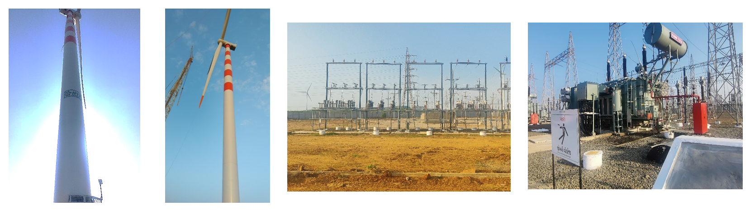
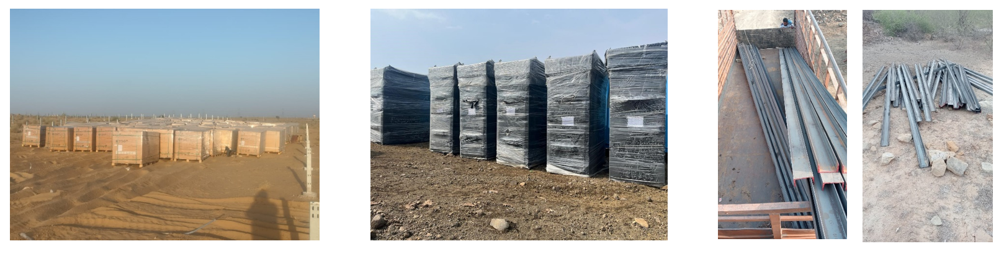
1200 MW Hybrid Power Projects (Tranche-IV)
PV modules
Wind Erection progress (NTPC)
Test Pile Stub
Solar Supply material on site (NTPC)
BACK
*Revised SCD is Actual date of LTOA + 60 Days ** Revised SCD is Actual date of LTOA S:Solar W:Wind ESS: Energy Storage

Slide 27
1200 MW Hybrid Power Projects (Tranche-V)
Description | HPD-1 | HPD-2 | HPD-3
Name | TP Surya Limited | AMP Energy | NTPC REL
Awded. Capacity | 600 MW (S:400 MW W:200MW ) | 120 MW (S:110 MW W:39.9MW) | 450 MW (S:380 MW W:126 MW)
Tariff | Rs. 2.53 / KWh | Rs. 2.53 / KWh | Rs. 2.53 / KWh
Project Location | Rajasthan | Rajasthan | Gujarat
Connectivity | Gadag-Wind-200MW- Koppal-Solar-300 MW, Bikaner-Solar-100MW | Fatehgarh-IV | KPS-2 Khavada SS
Effc. date of PPA | 11-01-2023 | 11-01-2023 | 11-01-2023
Shed.FC / Actual | 15.05.2024(on time) | 15.05.2024 (on time) | 15.05.2024 (on time)
SCD / Revised | 11.01.2025 / Actual start date of connectivity + 60 days |  | 11.01.2025/16.05.2025*
Buying Entity | MUL-1070 MW, WB CESC: 100 MW
Progress Status | TATA: 100 MW solar commissioned Land- Solar Completed; Wind- 294.35/460 acres acquired. Supply-Solar-Koppal-375/393 MWp delivered on site, Bikaner- completed; Wind- Delivery be completed by 18.11.25. Connectivity: Gadag-SS-27.12.2025 Koppal-SS-30.09.2025 Bikaner-SS-31.12.2025 | AMP: Land: completed for both solar and wind part Supply-Modules-Delivery expected by Jun 25 onwards & Wind: Reached at site Early commissioning of Project is planned. Connectivity- Exp-Sep 2025 | NTPC: Land: Solar- 1406/1406 acres; Wind- 200/300 completed. Supply-Major Supply Equipment- Solar and Wind-Supply is in progress; Connectivity- November, 2026
BACK
*Revised SCD due to delay in Tariff adoption; Further extn requested due to delay in GNA effectiveness, (proposal under review), S:Solar W:Wind

Slide 28
1200 MW Hybrid Peak Power Projects (Tranche-VI)
Description | HPD-1 | HPD-2 |  | HPD-3 | HPD-4
Name | Acme | AMP Energy |  | Hero | ReNew
Awar. Capacity | 380 MW | 100 MW |  | 120 MW | 600 MW
PPA signed Capacity# | 190 MW (S:309 MW W:91MW, ESS: 405 MWh) | 50 MW (S: 42.5 MW W:59.4MW ESS:100MWh) |  | 60 MW (S:75 MW W:79.2 MW ESS: 60 MWh) | 300 MW (S:435 MW W:250 MW ESS: 415 MWh)
Tariff | Rs. 4.73 / KWh | Rs. 4.64 / KWh |  | Rs. 4.72 / KWh | Rs. 4.69 / KWh
Assured Peak | 2 hours in the morning and 2 hours in the evening peak
Project Location | Andhra Pradesh | Andhra Pradesh | Andhra Pradesh | Andhra Pradesh | Andhra Pradesh
Connectivity | Kurnool III, Pachora & Ananthapuram; | Kurnool | Kurnool | Kurnool | Ananthapur
Effc. date of PPA | 30.01.2025 | 30.01.2025 | 30.01.2025 | 30.01.2025 | 30.01.2025
Shed.FC / Actual | 30.12.2025 | 30.12.2025 | 30.12.2025 | 30.12.2025 | 30.12.2025
SCD / Revised | 30.06.2026 |  | 30.06.2026 | 30.06.2026 | 30.06.2026
Buying Entity | 100 MW-Assam (APDCL) + 500 MW- (CSPDCL).
*Revised SCD due to delay in Tariff adoption; S:Solar W:Wind ESS: Energy Storage System # PSA signed for 50% capacity only

Slide 29
1200 MW Hybrid Peak Power Projects (Tranche-VI)
Description | HPD-1 | HPD-2 | HPD-3 | HPD-4
Name | Acme | AMP Energy | Hero | ReNew
Progress Status | Land: in progress. Supply –Solar & Wind finalized. Connectivity-30.06.2026,depend upon outcome of Case | Land: in progress. Supply - Discussion under progress. Connectivity-30.06.2026 depend upon outcome of Case | Land: in progress. Supply –Solar & Wind finalized. Connectivity-30.06.2026,depend upon outcome of Case | PPA signed on 22.10.2024. Connectivity-30.06.2026,depend upon outcome of Case
ISSUES:
NREDCAP stated that REIA CPSUs to include the permissions/approvals of the Petitioner/State Government as a mandatory pre-requisite before according power evacuation approvals to renewable energy developers applying for connectivity. To cancel all the power evacuation approvals granted to various developers at the 400/220 kV S/S in Anantapur, Andhra Pradesh and 765/400/220 kV S/S in Kurnool.
BACK
*Revised SCD due to delay in Tariff adoption; Further extn requested due to delay in GNA effectiveness, (proposal under review), S:Solar W:Wind

Slide 30
2000 MW Hybrid Power Projects (Tranche-VII)
Description | HPD-1 | HPD-2 | HPD-3
Name | NTPC | Sembcorp | Juniper
Award. Capacity | 300 MW (S:200MW W:100MW) | 450 MW (S:300MW W:150MW) | 150 MW (S:100MW W:50 MW)
Tariff | Rs.3.15/kWh | Rs. 3.21/kWh | Rs. 3.21/kWh
Project Location | Rajasthan | Rajasthan | Gujarat
Connectivity | Fatehgarh, Vanki, Jamjodhpur, Bellary | Fatehgarh, Nagaur Metra, Gadag-II | Bhadla-III, Fatehgarh-IV, Jam Khambaliya
Effc. date of PPA | 09.01.2025 | 09.01.2025 | 09.01.2025
Shed.FC / Actual | 09.01.2026 | 09.01.2026 | 09.01.2026
SCD / Revised | 09.01.2027 | 09.01.2027 | 09.01.2027
Buying Entity | 900 MW HPSEBL
Progress Status | Land identification: under progress. PSERC-Denied the power procurement approval. Presently, HPERC approved the tariff. PSA signed with HP Discom(HPSEBL) on 09.01.2025. Subsequently, SECI has signed the PPA with Effective date of 09.01.2025.
BACK
*Revised SCD is Actual date of LTOA + 60 Days ** Revised SCD is Actual date of LTOA S:Solar W:Wind ESS: Energy Storage

Slide 31
1200 MW with Assured Peak Power Supply
Description | HPD-1 | HPD-2
Name | Greenko | ReNew
Award. Capacity | 900 MW (S:1500 MW ESS:450 MW PSP) | 300MW (S:81 MW W:322MW ESS:150MWh)
Tariff | Rs. 6.12 Peak tariff & Rs. 2.88 Off peak | Rs. 6.85 Peak tariff & Rs. 2.88 Off peak
Project Location | Pinnapuram, Kurnool, A.P | Koppal District, Karnataka
Connectivity | Kurnool | Koppal CTU SS, Karnataka
Effc. date of PPA | 09.01.2025 | 09.01.2025
Shed.FC / Actual | 09.01.2026 | 09.01.2026
SCD / Revised | 09.01.2027 | 09.01.2027
Buying Entity | RUVNL (490 MW) + DVC (200 MW) +BSPHCL (210 MW) | GOA (150 MW) + HPPC (150 MW)
Progress Status | Land-Completed, Solar-52% completed PSP works –Trial run completed for 3 units Solar Supply: MMS, Modules, inverters, cables reached at site. Erection & Civil: Under progress Project Commissioning is aligned with completion of Narendra-Pune line (connectivity). | Land-Completed. Supply-Completed Erection & Civil-Completed The total commissioned Hybrid capacity of the project is 297.42 MW power is being scheduled to DISCOMs.
BACK
*Revised SCD is Actual date of LTOA + 60 Days ** Revised SCD is Actual date of LTOA S:Solar W:Wind ESS: Energy Storage

Slide 32
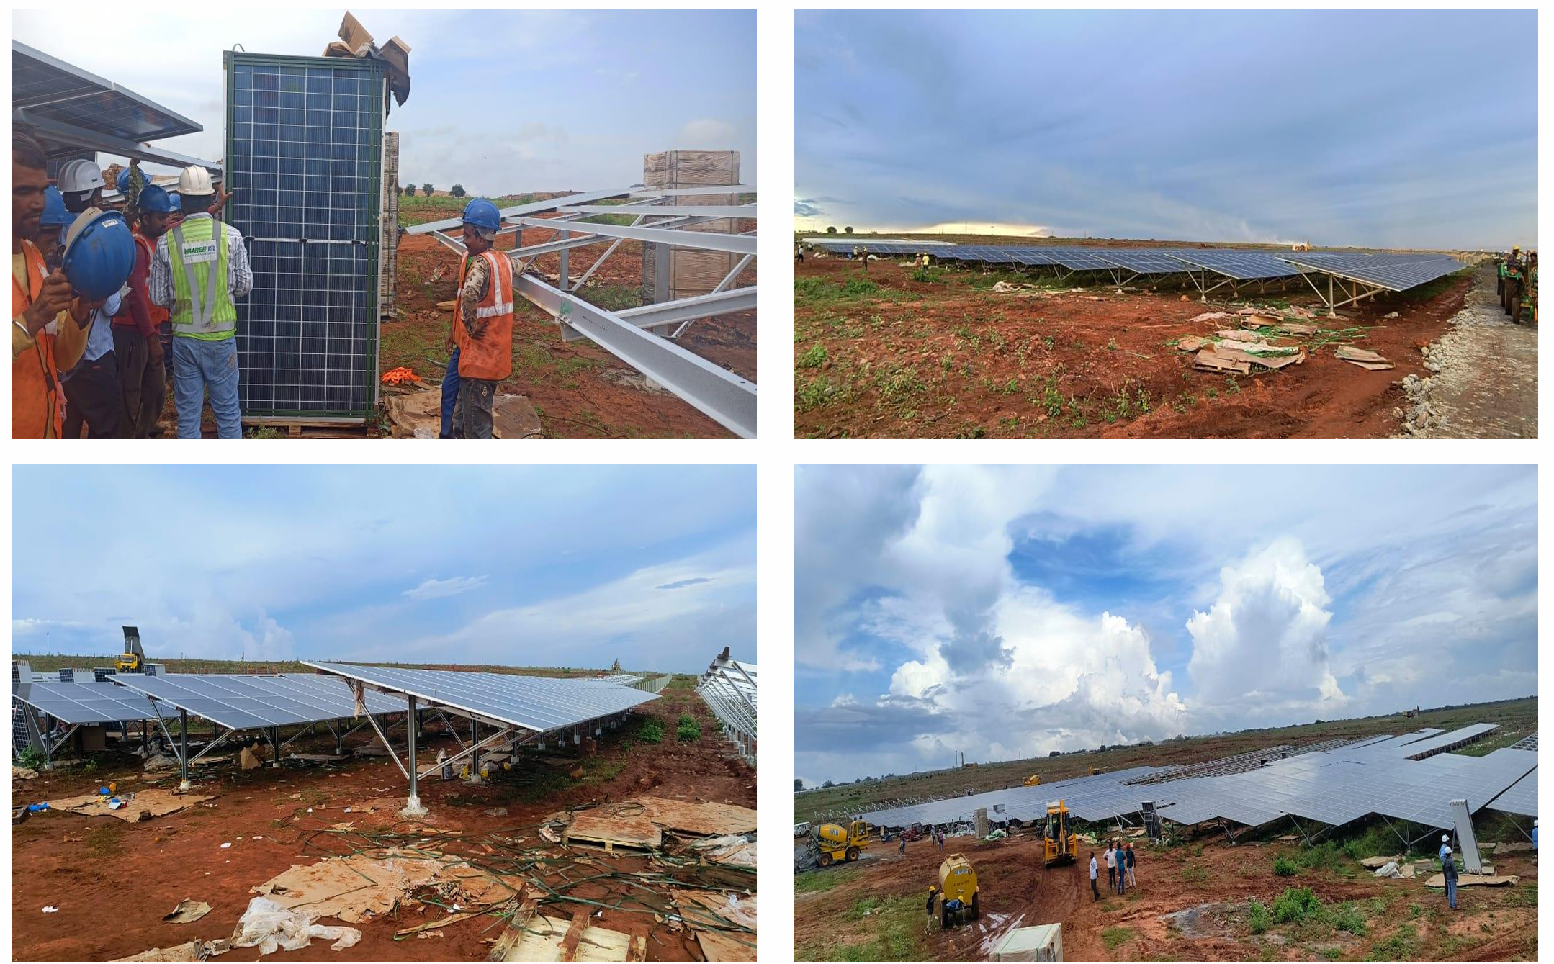
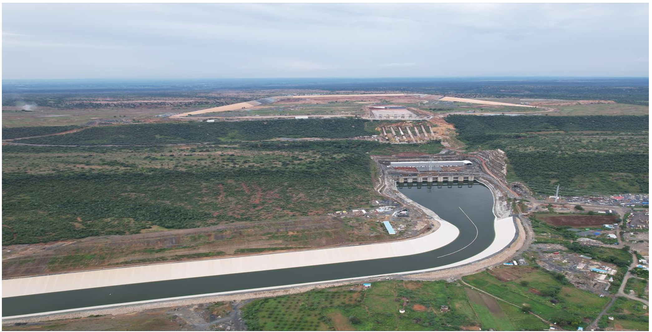
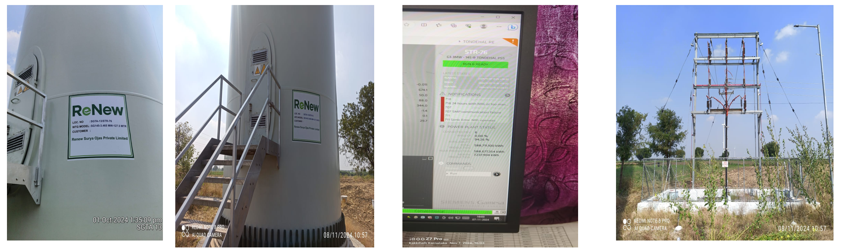
1200 MW with Assured Peak Power Supply
Solar Module Erection (Greenko)
Pumped Storage Plant (Greenko)
BACK
WTG installation progress ReNew

Slide 33
400 MW ISTS-Connected RTC RE Power (RTC-1)
Description | HPD
Name | ReNew
Award. Capacity | 400MW(S:400 MW W:900 MW ESS:8 MWh)
Tariff | Rs.2.90/kWh for 1st year escalation of 3% per annum for 15 years & fixed tariff thereafter.
Project Location | Solar: Rajasthan Fatehgarh (400 MW) Wind: Kallam, Maharashtra (300 MW) + Koppal (300MW) + Gadag (300MW), Karnataka
Connectivity | Fatehgarh-III SS, Kallam SS, Koppal SS, Gadag SS
Effc. date of PPA | 06-08-2021
Shed.FC / Actual | 22-07-2022 (Actual)
SCD / Revised | Original: 06-08-2023 Revised: 31.05.2025+60 days
Buying Entity | WBSECL (100 MW) + IPCL (100 MW)+ Uttarakhand (100 MW) + Railway (100 MW).
Progress Status | WTG’s installation at site are under progress. Solar-400 MW commissioned, and it is scheduled to respective Buying entities Wind-465.825 MW commissioned and it is scheduled to respective Buying entities. Land status: Koppal, Gadag- Completed, Fatehgarh-completed, Kallam-372/627 completed. Supply: Completed Erection: The completion of Project is aligned with Connectivity Connectivity: Expected by June, 2025
BACK
*Revised SCD is Actual date of LTOA + 60 Days ** Revised SCD is Actual date of LTOA S:Solar W:Wind ESS: Energy Storage

Slide 34
Pilot Project of Standalone BESS-500 MW/1000 MWh (ESS-1)
Description | HPD
Name | JSW Renew Energy Five Limited
Award. Capacity | 2x (250MW/500MWh )
Tariff | INR 1083500 /MW/Month
Project Location | Rajasthan
Connectivity | Fatehgarh-III SS
Effc. date of PPA | 05.03.2024 (250MW/500MWh)
Shed.FC / Actual | 05.03.2025 (Achieved)
SCD / Revised | 05.09.2025
Buying Entity | GUVNL-150 MW
Progress Status | OFF take Scope: 1. 60% of capacity i.e. 300 MW/600 MWh is in scope of SECI (Grid India may offtake 30% i.e. 150 MW/300 MWh, for balance 30 % -SECI to sale with DISCOMs) 2. 40% of capacity will be in the scope of Developer. Land Status: Lease agreement signed for Project-1 & Project-2 Major Supply Equipment: BESS Containers- Order placed on Civil & Erection works: Grading & leveling started Connectivity: Exp-June 2025 Remarks: Tariff adoption is cancelled in CERC in Jan 2025. BESS-D filed petition in APTEL in Feb 2025. Matter is posted on 03.07.2025
*Revised SCD is Actual date of LTOA + 60 Days ** Revised SCD is Actual date of LTOA S:Solar W:Wind ESS: Energy Storage

Slide 35
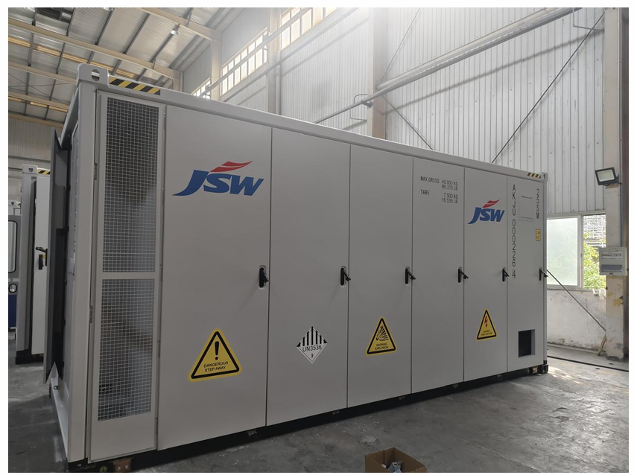
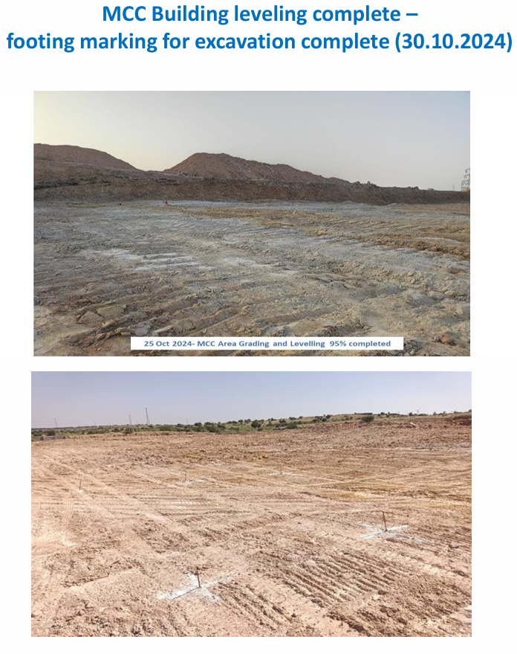
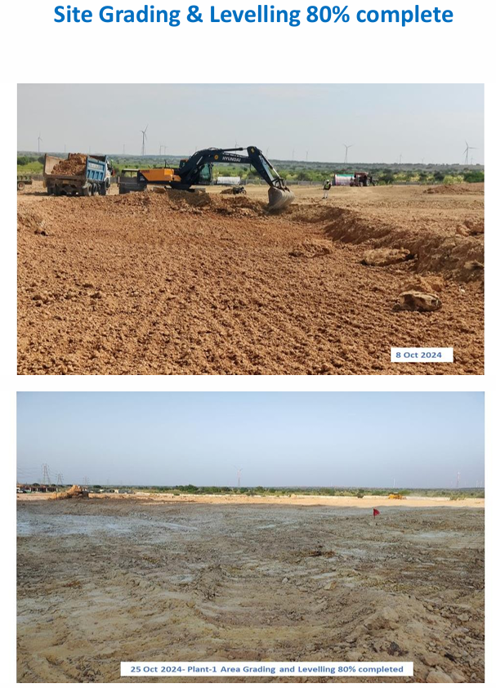
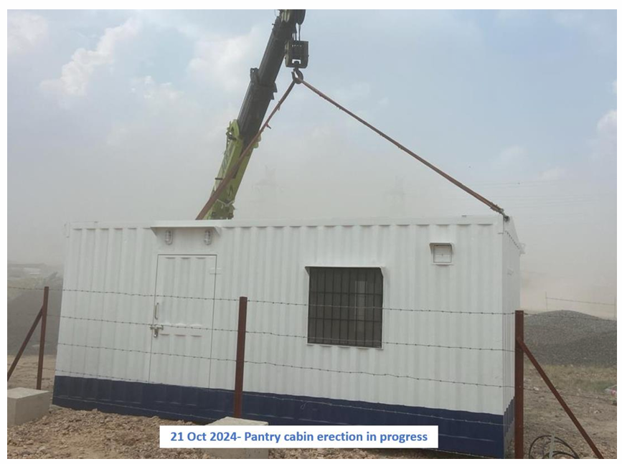
Pilot Project of Standalone BESS-500 MW/1000 MWh (ESS-1)
Battery containers (empty)
BACK
Pantry Porta Cabin

Slide 36
BESS project of 125 MW/500 MWh (ESS-3)
Description | HPD
Name | JSW Neo Energy Limited
Award. Capacity | 125 MW/ 500 MWh
Tariff | 4,41,000 INR/MW/Month
Project Location | Mylatti PS Kerala
Connectivity | 220 kV Mylatti PS Kerala.
Effc. date of PPA | 17.04.2025 (250MW/500MWh)
Shed.FC / Actual | 16.01.2025 (Achieved)
SCD / Revised | 16.12.2026
Buying Entity | KSEBL
Progress Status | Recently, SECI has signed the BESPA with M/s JSW for 125 MW/ 500 MWh with M/s JSW with Effective date of 17.04.2025 and the Project is under execution. KSEB is proposed to sign the land agreement with M/s JSW on 07.07.2025
BACK
ESS: Energy Storage

Slide 37
Tranche-wise Progress Status (Wind)

Slide 38
Tranche – 1 (Tariff: Rs. 3.46 /kWh)
Effective date of PPA: 21.07.2017
Sr. No. | WPD | PPA Capacity (MW) | Commissioned Capacity (MW) | Remarks
1 | Mytrah Vayu (Sabarmati) Private Limited | 250 | 250 | -
2 | Green Infra Renewable Energy Limited | 249.9 | 249.9 | -
3 | Wind One Renergy Private Limited | 50 | 50 | -
4 | Wind Two Renergy Private Limited | 50 | 50 | -
5 | Wind Three Renergy Private Limited | 50 | 50 | -
6 | Wind Four Renergy Private Limited | 50 | 0 | Project stands cancelled.
7 | Wind Five Renergy Private Limited | 50 | 50 | Under litigation.
8 | Ostro Kutch Wind Private Limited | 250 | 250 | -
9 | Adani Green Energy (MP) Limited | 50 | 50 | -
 | Total | 1049.9 | 999.9
Note: PPAs under this Tranche signed between WPD and M/s PTC Ltd
Back

Slide 39
Tranche – 2 (Tariff: Rs. 2.64-2.65/kWh)
Effective date of PPA: 19.12.2017 – 02.01.2018
Sr. No. | WPD | PPA Capacity (MW) | Commissioned Capacity (MW) | Remarks
1 | ReNew Power Private Limited | 250 | 230.1 | 19.9 MW stands cancelled.
2 | Haroda Wind Energy Private Limited | 50 | 0 | Projects stand cancelled.
3 | Khatiyu Wind Energy Private Limited | 50 | 0
4 | Vigodi Wind Energy Private Limited | 50 | 0
5 | Ravapar Wind Energy Private Limited | 50 | 0
6 | Inox Clean Energy Limited | 50 | 30 | 20 MW stands terminated.
7 | Greenko Wind Power Private Limited | 200 | 200 | -
8 | Sembcorp Green Infra Private Limited | 250 | 250 | -
9 | Adani Wind Energy Kutchh One Limited | 50 | 50 | -
 | Total | 1000 | 760.1
Back

Slide 40
Tranche – 3 (Tariff: Rs. 2.44-2.45/kWh)
Effective date of PPA: 24.05.2018
Sr. No. | WPD | PPA Capacity (MW) | Commissioned Capacity (MW) | Remarks
1 | ReNew Wind Energy (AP2) Private Limited | 400 | 300 | Under litigation to the extent of 100 MW project capacity.
2 | Sembcorp Green Infra Pvt Limited | 300 | 300 | -
3 | Inox Green Energy Services Limited | 200 | 0 | Under litigation
4 | Torrent Power Limited | 499.8 | 0 | Under litigation
5 | Alfanar Energy Private Limited | 300 | 300 | -
6 | Adani Green Energy (MP) Limited | 250 | 0 | Under litigation
7 | Betam Wind Energy Private Limited | 50.2 | 50.2 | -
 | Total | 2000 | 950.2
Back

Slide 41
Tranche – 4 (Tariff: Rs. 2.51-2.52/kWh)
Effective date of PPA: 30.08.2018
Sr. No. | WPD | PPA Capacity (MW) | Commissioned Capacity (MW) | Remarks
1 | Continuum Power Trading (TN) Private Limited | 250 | 88 | Under litigation to the extent of 126 MW. 124 MW stands cancelled.
2 | Sprng Renewable Energy Private Limited | 300 | 300
3 | Avikiran Solar India Private Limited | 285 | 165.9 | Under dispute to the extent of 2.1 MW. 117 MW stands cancelled.
4 | Vivid Solaire Energy Private Limited | 200 | 168 | 32 MW stands cancelled.
5 | Inox Green Energy Services Limited | 100 | 0 | Under litigation
6 | Adani Wind Energy Kutchh Two Limited | 300 | 0 | Project stands cancelled.
7 | Mytrah Vayu (Brahmaputra) Private Limited | 300 | 0 | Under litigation
8 | ReNew Wind Energy (TN) Private Limited | 265 | 0 | Under litigation
 | Total | 2000 | 721.9
Back

Slide 42
Tranche – 5 (Tariff: Rs. 2.76-2.77/kWh)
Effective date of PPA: 22.01.2019
Sr. No. | WPD | PPA Capacity (MW) | Commissioned Capacity (MW) | Remarks
1 | Torrent Solargen Limited | 115 | 115 | -
2 | Adani Wind Energy Kutchh Four Limited | 300 | 0 | Project stands cancelled.
3 | Netra Wind Private Limited | 300 | 206.5 | 93.5 MW stands cancelled.
4 | Sitac Kabini Renewables Private Limited | 300 | 300 | -
5 | Boreas Renewable Energy Private Limited | 175 | 0 | Under litigation.
 | Total | 1190 | 621.5
Back

Slide 43
Tranche – 6 (Tariff: Rs. 2.82-2.83/kWh)
Effective date of PPA: 15.09.2019
Sr. No. | WPD | PPA Capacity (MW) | Commissioned Capacity (MW) | Remarks
1 | Adani Wind Energy Kutchh Three Limited | 250 | 250 | -
2 | Ostro Kannada Power Pvt Ltd | 300 | 199.5 | 100.5 MW stands cancelled.
3 | Powerica Limited | 50.6 | 50.6 | -
4 | Adani Wind Energy MP One Private Limited | 324.4 | 324.4 | -
5 | Morjar Windfarm Development Pvt. Ltd. | 150 | 148.5 | 1.5 MW stands cancelled.
6 | Zenataris Renewable Energy Private Limited | 125 | 0 | WPD failed to execute PPA.
 | Total | 1200 | 973
Back

Slide 44
Tranche – 7 (Tariff: Rs. 2.79-2.83/kWh)
Effective date of PPA: 18.10.2019
Sr. No. | WPD | PPA Capacity (MW) | Commissioned Capacity (MW) | Remarks
1 | Betam Wind Energy Private Limited | 200 | 0 | WPD failed to execute PPA.
2 | Ostro Energy Private Limited | 50 | 50
3 | Sprng Wind Energy Private Limited | 100 | 0 | Project stands cancelled.
4 | Adani Wind Energy Kutchh Five Limited | 130 | 130 | -
 | Total | 480 | 180
Back

Slide 45
Tranche – 8 (Tariff: Rs. 2.83-2.84/kWh)
Effective date of PPA: 21.05.2020
Sr. No. | WPD | PPA Capacity (MW) | Commissioned Capacity (MW) | Remarks
1 | Apraava Energy Private Limited | 250.71 | 250.71 | -
2 | Tunga Renewable Energy Private Limited | 189.93 | 0 | Under litigation
 | Total | 480.8 | 250.71
Back

Slide 46
Tranche – 9 (Tariff: Rs. 2.99-3.00/kWh)
Effective Date of PPA: 31.03.2021 for 700 MW and 15.07.2021 for 270 MW
Sr. No. | WPD | PPA Capacity (MW) | Commissioned Capacity (MW) | Remarks
1 | Vena Energy Vidyuth Private Limited | 160 | 160 | -
2 | JSW Renew Energy Limited | 540 | 540 | -
3 | JSW Renew Energy Limited | 270 | 162 | Under execution (Revised SCD is 30.11.2025)
 | Total | 970 | 862
Back

Slide 47
Tranche – 10 (Tariff: Rs. 2.77-2.78/kWh)
Effective Date of PPA: 10.09.2021
Sr. No. | WPD | PPA Capacity (MW) | Commissioned Capacity (MW) | Remarks
1 | Adani Renewable Energy Seven Limited | 300 | 0 | Under litigation
2 | Ayana Renewable Power Six Private Limited | 300 | 300 | -
3 | Viento Renewables Private Limited | 150 | 0 | Under litigation
4 | JSW Renew Energy Two Limited | 150 | 150 | -
5 | JSW Renew Energy Two Limited | 300 | 300 | -
 | Total | 1200 | 750
Back

Slide 48
Tranche – 11 (Tariff: Rs. 2.69-2.70/kWh)
Effective Date of PPA: 30.06.2022
Sr. No. | WPD | PPA Capacity (MW) | Commissioned Capacity (MW) | Remarks
1 | ReNew Naveen Urja Private Limited | 300 | 0 | Under litigation.
2 | Green lnfra Wind Energy Limited | 180 | 54.6 | Under execution (Revised SCD is 26.07.2025)
3 | Anupavan Renewables Private Limited | 150 | 0 | Under litigation.
4 | Adani Renewable Energy Holding Fifteen Limited | 450 | 0 | Under litigation.
5 | Two Wind Energy Private Limited | 120 | 0 | No progress FC not achieved (Due Date 26.01.2024) Revised SCD is 26.07.2025
 | Total | 1200 | 54.6
Back

Slide 49
Tranche – 12 (Tariff: Rs. 2.89-2.94/kWh)
Effective date of PPA: 29.03.2023
Sr. No. | WPD | PPA Capacity (MW) | Commissioned Capacity (MW) | Remarks
1 | Halvad Renewables Private Limited | 300 | 0 | WPD failed to execute PPA.
2 | JSW Renew Energy Three Limited | 300 | 0 | Financial Closure achieved. Under execution. (Revised SCD is 23.01.2026)
3 | NTPC Renewable Energy Limited | 200 | 0 | Financial Closure achieved. Under execution. (Revised SCD is 23.01.2026)
4 | Torrent Saurya Urja 2 Private Limited | 300 | 0 | Financial Closure achieved. Under execution. (Revised SCD is 23.01.2026)
 | Total | 1100 | 0
Back

Slide 50
Tranche – 13 (Tariff: Rs. 2.9-2.95/kWh)
Effective date of PPA: 26.06.2023
Sr. No. | WPD | PPA Capacity (MW) | Commissioned Capacity (MW) | Remarks
1 | SJVN Green Energy Limited | 100 | 0 | No progress FC not achieved (Due Date 26.01.2024) Revised SCD is 02.12.2025
2 | Scatec India Renewables One Private Limited | 300 | 0 | Under litigation
3 | Teq Green Power XI Private Limited | 200 | 0 | Under dispute in DRC FC not achieved (Due Date 26.01.2024) Revised SCD is 02.12.2025
 | Total | 600 | 0
Back

Slide 51
Tranche – 14 (Tariff: Rs. 3.18-3.24/kWh)
Effective date of PPA: 16.11.2023
Sr. No. | WPD | PPA Capacity (MW) | Commissioned Capacity (MW) | Remarks
1 | Green Prairie Energy Private Limited | 190 | 0 | WPD failed to execute PPA.
2 | Apraava Energy Private Limited | 300 | 0 | FC not achieved (Due Date 16.06.2024) Revised SCD is 27.12.2025 WPD’s request for extension in FC and SCD is under review (referred to MNRE)
3 | SJVN Green Energy Limited | 200 | 0 | No progress FC not achieved (Due Date 16.06.2024) Revised SCD is 27.12.2025
 | Total | 690 | 0
Back

Slide 52
Tranche – 16 (Tariff: Rs. 3.6-3.7/kWh)
Effective date of PPA: 13.06.2024
Sr. No. | WPD | PPA Capacity (MW) | Commissioned Capacity (MW) | Remarks
1 | Torrent Solar Power Private Limited | 100 | 0 | Under execution (Revised SCD is 19.06.2026)
2 | JSW Renew Energy Eight Limited | 700 | 0
3 | JSW Renew Energy Four Limited | 150 | 0
4 | JSW Renew Energy Four Limited | 175 | 0
5 | Powerica Limited | 50 | 0
 | Total | 1175 | 0
Back

Slide 53
Tranche – 17 (Tariff: Rs. 3.81-3.82/kWh)
Effective date of PPA: 01.03.2025
Sr. No. | WPD | PPA Capacity (MW) | Commissioned Capacity (MW) | Remarks
1 | Powerica Limited | 50 | 0 | Under execution. (Revised SCD is 01.09.2027)
2 | Adyant Renewables Private Limited | 50 | 0 | Tariff not adopted by CERC.
 | Total | 100 | 0
Back

Slide 54
ISTS WIND POWER PROJECTS – Terminated Capacity
Status | Tranche | WPD | State | PPA Capacity (MW) | Commissioned Capacity (MW) | Terminated (MW)
CAPACITY NOT INSTALLED BY WPD | I | Wind Four Renergy Pvt Ltd (SPV of M/s Inox) | Gujarat | 50 | 0 | 50
 | II | ReNew Power Pvt Ltd | Gujarat | 250 | 230.1 | 19.9
 | II | Inox Clean Energy Ltd (SPV of M/s Inox) | Gujarat | 50 | 30 | 20
UNILATERALLY TERMINATED | II | Haroda Wind Energy Pvt Ltd (SPV of M/s Inox) | Gujarat | 50 | 0 | 50
 | II | Khatiyu Wind Energy Pvt Ltd (SPV of M/s Inox) | Gujarat | 50 | 0 | 50
 | II | Vigodi Wind Energy Pvt Ltd (SPV of M/s Inox) | Gujarat | 50 | 0 | 50
 | II | Ravapar Wind Energy Pvt Ltd (SPV of M/s Inox) | Gujarat | 50 | 0 | 50
CAPACITY NOT INSTALLED BY WPD | IV | Adani Wind Energy Kutchh Two Ltd | Gujarat | 300 | 0 | 300
 | IV | Avikiran Solar India Pvt Ltd | Gujarat | 285 | 165.9 | 117
 | IV | Vivid Solaire Energy Pvt Ltd | Tamil Nadu | 200 | 168 | 32
 | IV | Continuum Power Trading (TN) Pvt Ltd | Gujarat | 250 | 88 | 124
 | V | Adani Wind Energy Kutchh Four Ltd | Gujarat | 300 | 0 | 300
 | V | Netra Wind Private Limited | Gujarat | 300 | 206.5 | 93.5
 | VI | Morjar Windfarm Development Pvt Ltd | Gujarat | 150 | 148.5 | 1.5
 | VI | Ostro Kannada Power Pvt Ltd | Karnataka | 300 | 199.5 | 100.5
UNILATERALLY TERMINATED | VII | Sprng Wind Energy Pvt Ltd | Madhya Pradesh | 100 | 0 | 100
TARIFF NOT ADOPTED BY CERC | XVII | Adytant Renewables Pvt Ltd | Maharashtra | 50 | 0 | 50
TOTAL |  |  |  | 2785 | 1236.5 | 1508.4
Back

Slide 55
ISTS WIND POWER PROJECTS – Disputed Capacity – Part 1 of 2
Sl No. | Status | Tranche | PPA-signing Entity | PPA Capacity (MW) | Original/ Last Revised SCD | Status of LD | Petition/ Appeal No. and Date of filing and stage
1 | UNILATERALLY TERMINATED AND UNDER LITIGATION WITH EXPIRED PROJECT TIMELINES | III | Adani Green Energy (MP) Ltd | 250 | 24.11.2019/ Nil | Recovered | Appeal No. 299/ 2024 in APTEL/ 26.06.2024/ Hearing ongoing
2 |  | III | ReNew Wind Energy (AP2) Pvt Ltd | 100 | 24.11.2019/ 31.08.2021 | Stayed by CERC | Petition No. 56/MP/2022 in CERC / 06.02.2022/ Hearing ongoing
3 |  | III | Torrent Power Ltd | 499.8 | 24.11.2019/ Nil | Recovered | Appeal No. 152/2024 in APTEL / 01.04.2024/ Hearing ongoing
4 |  | IV | Mytrah Vayu (Brahmaputra) Pvt Ltd | 300 | 29.02.2020/ 28.08.2020 | Recovered | Appeal No. 29/2024 in APTEL / 16.01.2024/ Hearing ongoing
5 |  | IV | ReNew Wind Energy (TN) Pvt Ltd | 265 | 29.02.2020/ Nil | Recovered | Appeal No. 691/2023 in APTEL / 19.06.2023/ Hearing ongoing
6 |  | V | Boreas Renewable Energy Pvt Ltd | 175 | 22.07.2020/ 22.12.2020 | Recovered | Appeal No. 109/2025 in APTEL / 19.03.2025/ Hearing ongoing
7 |  | X | Adani Renewable Energy Seven Ltd | 300 | 10.03.2023/ 11.06.2023 | Recovered | Petition No. 4/MP/2024 in CERC / 13.11.2023/ Hearing ongoing
8 |  | X | Viento Renewables Pvt Ltd | 150 | 10.03.2023/ 09.10.2024 | In process of recovering LD | Petition No. 356/MP/2024 in CERC / 11.07.2025/ Hearing ongoing
9 | UNILATERALLY TERMINATED AND UNDER LITIGATION BUT PROJECT TIMELINES NOT LAPSED | XI | Adani Renewable Energy Four Ltd | 450 | 30.12.2023/ 26.07.2025 | Not recovered | Petition No. 348/MP/2023 in CERC / 19.10.2023/ Hearing ongoing
10 |  | XI | ReNew Naveen Urja Pvt Ltd | 300 | 30.12.2023/ 26.07.2025 |  | Petition No. 169/MP/2024 in CERC / 17.04.2024/ Hearing ongoing
11 |  | XI | Anupavan Renewables Pvt Ltd | 150 | 30.12.2023/ 26.07.2025 |  | Petition No. 178/MP/2025 in CERC / 29.11.2024/ Hearing ongoing
12 |  | XIII | Scatec India Renewables One Pvt Ltd | 300 | 26.06.2025/ 02.12.2025 |  | Petition No. 26/MP/2024 in CERC / 24.01.2024/ Order reserved
 |  |  | TOTAL | 3239.8

Slide 56
ISTS WIND POWER PROJECTS – Disputed Capacity – Part 2 of 2
Sl No. | Status | Tranche | PPA-signing Entity | PPA Capacity (MW) | Disputed Capacity (MW) | Original/ Last Revised SCD | Status of LD | Petition/ Appeal No. and Date of filing and stage
13 | SEEKING EXTENSION IN PROJECT TIMELINES | III | Inox Green Energy Services Ltd | 200 | 200 | 24.11.2019/ 31.08.2022 | Recovered | Petition No. 307/MP/2024/ CERC/ 03.09.2024/ Hearing ongoing
14 |  | IV | Inox Green Energy Services Ltd | 100 | 100 | 29.02.2020/ 31.08.2022 | Recovered | Petition No. 308/MP/2024/ CERC/ 03.09.2024/ Hearing ongoing
15 |  | IV | Avikiran Solar India Pvt Ltd | 285 | 2.1 | 29.02.2020/ 17.03.2022 | Recovered | Petition No. 180/MP/2024/ CERC/ 30.04.2024/ Hearing ongoing
16 |  | IV | Continuum Power Trading (TN) Pvt Ltd | 250 | 38 | 29.02.2020/ 21.12.2022 | Recovered | SLP No. 15096-15097/2024/ SCI/ 10.07.2024 Hearing Ongoing.
17 |  | VIII | Tunga Renewable Energy Pvt Ltd | 189.93 | 189.93 | 21.11.2021/ 05.09.2022 | Not Recovered | Petition No. 339/MP/2024/ CERC/ 14.11.2022/ Hearing ongoing
 |  |  | TOTAL | 1024.93 | 530.03
Disputed Capacity => 3239.8 MW + 530.03 MW = 3769.83 MW
Back

Slide 57
ISTS WIND POWER PROJECTS – Not coming up/ Not likely to come up
Sl No. | Tranche | PPA-signing Entity | PPA Capacity (MW) | Original/ Last Revised SCD
1 | XI | Two Wind Energy Private Limited | 120 | 30.12.2023/ 26.07.2025
2 | XIII | Teq Green Power XI Pvt Ltd | 200 | 26.06.2025/ 02.12.2025
3 | XIII | SJVN Green Energy Ltd | 100 | 26.06.2025/ 02.12.2025
4 | XIV | SJVN Green Energy Ltd | 200 | 16.11.2025/ 27.12.2025
 |  | TOTAL | 620
Terminated + Disputed + Capacity not coming up=> 5898 MW
Back

Slide 58
Current Issues:
As response to SECI, HPD vide letter/ e-mail dated 30 May/03 Jun, 2025 has submitted a letter seeking extension in SCD and submit the following:
Preliminary activities for the project were taken up envisaging connectivity at the Tuticorin PGCIL substation. However due to non-availability, fresh connectivity approval was obtained from PGCIL Bhuj Pooling Station, compelling shift of project location to Bhuj District, Gujarat with start of connectivity from 31.07.2026.
LoA issued to M/s Enerture Technologies Limited for 100 MW Solar Project at Bhuj District. Order have been placed for Modules & Inverters. Considering connectivity approval, the project is expected to be commissioned before connectivity approval date. i.e. 31.07.2026. Land transfer is under progress.
LoA issued to M/s INOX wind limited for 50 MW Wind project at Dayapar, Gujarat. 7 Wind Turbo Generators (WTG) erection completed, 9 WTG foundation work completed and the project is expected to be commissioned before the connectivity approval date. i.e. 31.07.2026. 25 WTGs (2 MW) received at site.
Every action is being undertaken for commissioning before the scheduled connectivity date, by temporary means in discussion with PGCIL/CTUIL. Sincere efforts are being taken to operationalize the connectivity through TGNA regulations.

Slide 59
HYBRID SCHEMES: AT A GLANCE
Tranche | Tendered Capacity (MW) | Awarded Capacity (MW) | PPA Signed Capacity (MW) | PPA Effective Date | SCD | Solar (MW) | Wind (MW) | Storage (MW) (MWh) |  | Tariff
I | 1200 | 840 | 840 | 07-11-2019 | 06-11-2021 | 780 | 205 | - | - | 2.67-2.69
II | 1200 | 600 | 600 | 15-01-2020 | 14-01-2022 | 600 | 150 | - | - | 2.69
III | 1200 | 1110 | 1110 | 19-07-2021 | 19-07-2023 | 1062.5 | 370.1 | - | - | 2.41
Peak Power | 1200 | 1200 | 1200 | 02-02-2022 | 02-02-2024 | 1581 | 322.25 | 525 | 2850 | Off peak- 2.88 Peak 6.12-6.85
RTC-I | 400 | 400 | 400 | 06-08-2021 | 06-08-2023 | 400 | 900 | 2 | 8 | 2.9 with 3% escalation for 15 year
IV | 1200 | 1200 | 1200 | 28-06-2022 | 27-06-2024 | 850 | 400 | - | - | 2.34-2.35
V | 1200 | 1170 | 1170 | 11-01-2023 | 10-01-2025 | 810 | 390 | - | - | 2.53
VI | 1200 | 1200 | 600 | 30-06-2024 | 30-06-2026 | 1663 | 1359.2 | 1630 | 1630 | 4.64-4.73
ESS-I | 500 | 500 | 250 | 05-03-2024 | 05-03-2026 | - | - | 500 | 1000 | Rs. 10.835 lakh/month

Slide 60
HYBRID SCHEME: AT A GLANCE
Tranche | Tendered Capacity (MW) | Awarded Capacity (MW) | PPA Signed Capacity (MW) | PPA Effective Date | SCD | Solar (MW) | Wind (MW) | Storage (MW) (MWh) |  | Tariff
ESS-I | 500 | 500 | 250 | 05-03-2024 | 05-03-2026 | - | - | 500 | 1000 | Rs. 10.835 lakh/month
VII | 2000 | 900 | 900 | 09-01-2025 | 09-01-2027 | 600 | 300 | - | - | 3.15-3.21
VIII | 1200 | 1200 | 0 | PSA yet to be signed | - | 1040 | 403 | - | - | 3.43-3.46
FDRE-IV | 1260 | 630 | 0 | 30-06-2025 | - | 273 | 683 | 66 | 177 | 4.98-4.99
IX | 600 | 600 | 0 | PSA yet to be signed | - | 580 | 200 | - | - | 3.25-3.26
FDRE-VI | 2000 | 200 | 0 |  | - | 136 | - | 200 | 800 | 8.5
ESS 3 | 125 | 125 | 125 | 17.04.2025 | 16.12.2026 | - | - | 125 | 500 | 4,41,000/MW/Month
Total | 13985 | 11875 | 8395 |  |  | 10375.5 | 5682.55 | 3048 | 6965
Back

Slide 61
Typical Project Progress Format Submitted by WPDs

Slide 62

PROJECT BRIEF – TORRENT POWER LIMITED- TRANCHE-XII
Project Name | Details
Site Location | 300 MW SECI Xll, Todkibad, Karnataka
WTG Configuration | S114_140M HLT_3.0
Capacity | 3MW
Machines (Nos) | 100
WTG Supplier/OEM | Suzlon Energy Ltd
Details of EPC including Land Aggregator | Suzlon Gujarat Wind Park Ltd

Slide 63
PRESENT STATUS FOR PROJECT DEVELOPMENT
APPROVAL & CLEARANCES | STATUS
Land Required / Acquired | 100/37
MOD Application Date | NA
MOD Approval Status | NA
SNA Application Date | 28-03-2023
SNA Approval Status | GO enhancement from 2.1 MW to 3 MW for 200 MW needs to be done
Order of Supply of WTG | YES
WTGs fully received at site / in transit | Not yet dispatch
WTG Foundation completed / In Progress | Soil test work in progress. Foundation casting to start from the month of Dec 2024
WTG Erection completed / In Progress | Not Yet
GRID | STATUS
Connectivity Application Date | 18-05-2023
As per CTU connectivity start date | 23-01-2026
GNA Status | Final Grant of connectivity Received
Con-4 Application Date & status | Tentative CON-TD data submitted on NSWS portal
Dynamic VAR Compensation status | Order Placed
Trial Run Status (In process/Completed) | 0%
PSS status | PSS land & EPC Vendor finalised
As per CTU evacuation system planning | Land work in Progress
Commissioning plan | 23-01-2026

Slide 64
PRESENT STATUS FOR PROJECT DEVELOPMENT
ELECTRICAL BoP(EHV) | STATUS
RoW Agreement (Required / Acquired) | 0%
Excavation (Completed / In process) | 6%
EHV Foundation (Completed / In process) | 7.36%
EHV Erection completed | 0%
Stringing (Required / Completed/ In process) | 0%
EQUIPMENT SUPPLY | STATUS
EHV tower Material | 0%
Anchor Cages / Stub | 12%
PSS –Power Transformer | 0%
EHV-Al-59 Moose Conductor | 0%
EHV Hardware and Insulator | 0%
RESOURCES | STATUS
WTG subcontractor's mobilization | Yes
EHV Foundation subcontractors mobilization | 0%
EHV Erection subcontractor's mobilization | 0%
PSS Civil contractor mobilization | 0%
ELECTRICAL BoP(USS & 33KV) | STATUS
USS Readiness | 0%
33kv line Work | 0%
ELECTRCAL BoP (PSS) | STATUS
Land Acquisition | Done
Execution | 0%
Control room Construction | 0%
220KV & 33KV Gantry & Structures | 0%
220KV Equipment foundation | 0%
Transformer Erection | 0%
CIVIL BoP | STATUS
Soil Test | 100/38
Excavation | 100/06
WTG Foundation | 100/00
WTG Erection completed | 100/00
WTG Pre commission | 100/00

Slide 65
COMMISSIONING PLAN: SUBMITTED BY WPD
WTGs already erected and ready for commissioning | WTGs erected however not ready for commissioning or under process of pre-commissioning | FTC application already filed for capacity | Additional FTC application proposed to be filed for Capacity | Pending point w.r.t. FTC if, any | Status of Dynamic VAR Compensation | Trial Run Status (Completed /under process)
- | - | - | - | - | - | -
- | - | - | - | - | - | -
- | - | - | - | - | - | -
Quarter-wise Commissioning Target:
S. No. | Month | Capacity
1 | Aug 25 | 75 MW
2 | Sep 25 | 75 MW
3 | Oct 25 | 75 MW
4 | Nov 25 | 75 MW
CRITICAL ISSUES – Shared by WPD Land acquisition is constraint. Bay coordinates pending. EHV line survey half pending due to coordinates awaited

Slide 66
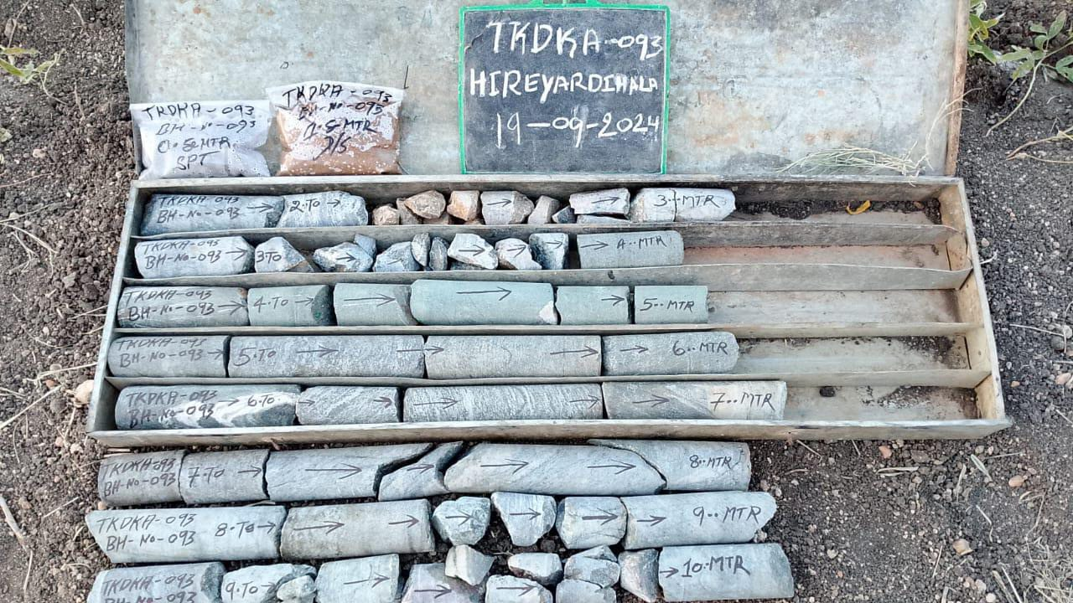
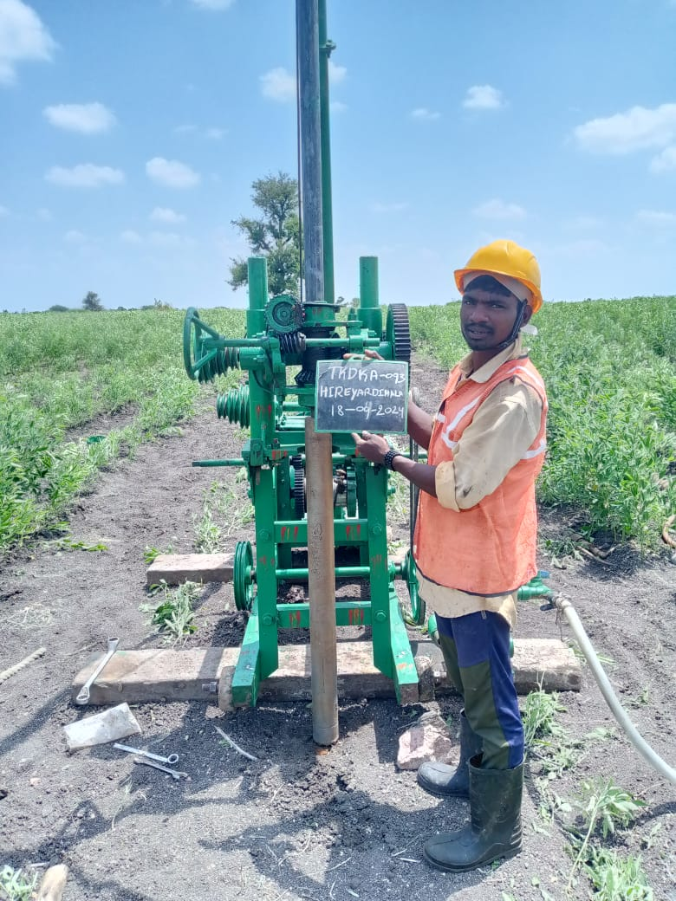
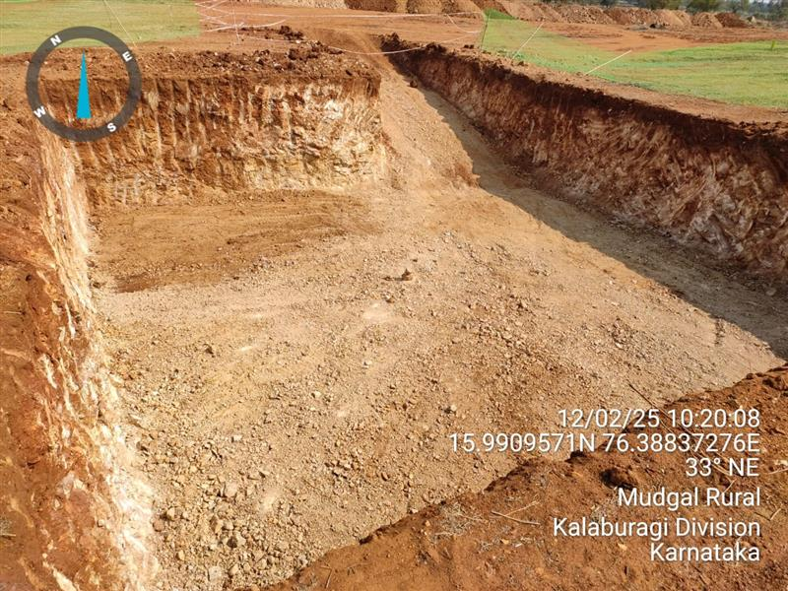
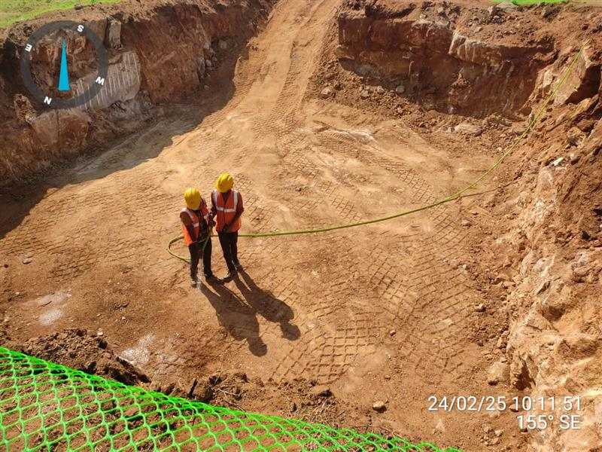
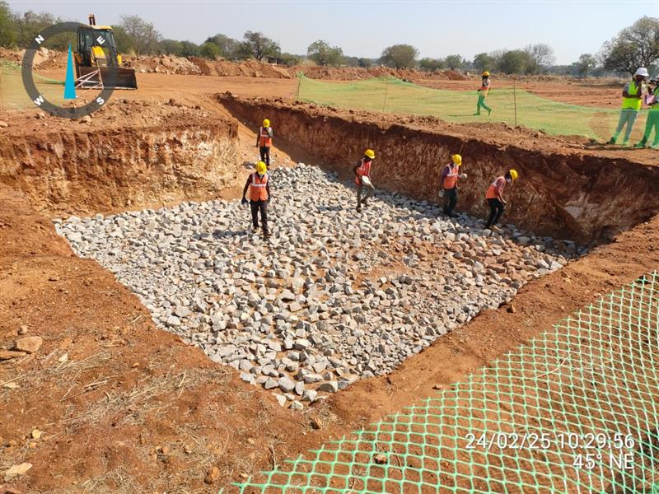
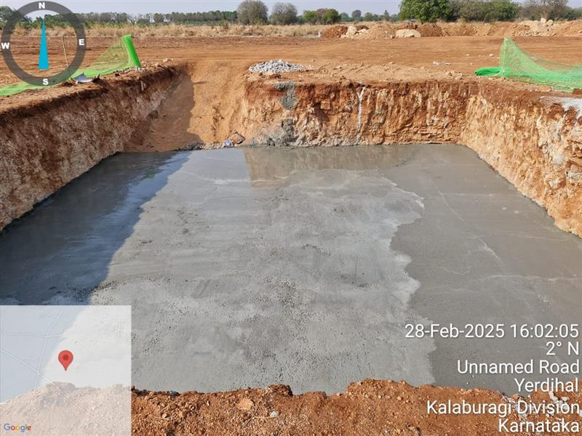
SITE PHOTOGRAPHS

Slide 67
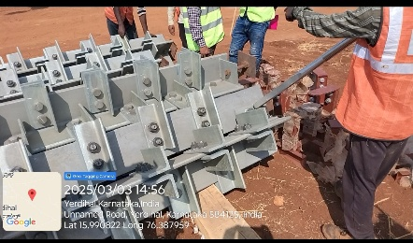
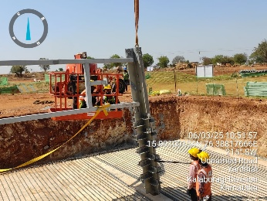
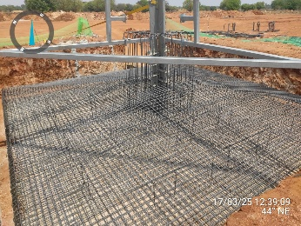
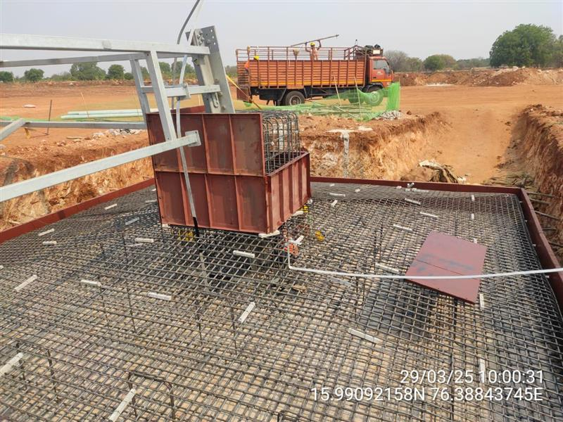
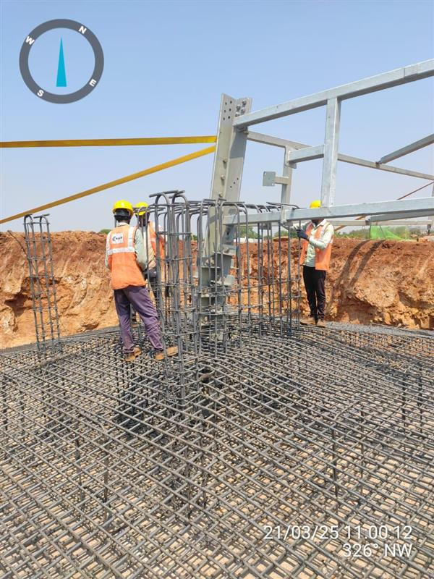
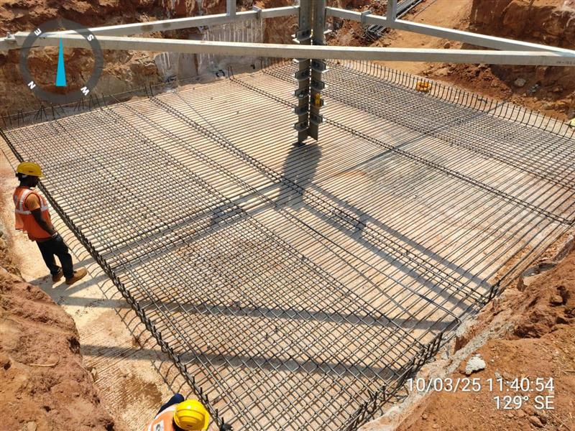
SITE PHOTOGRAPHS

Slide 68
Change in Law Claims: Tranche-I & II
Tranche-I – 390 MW (2x195 MW) 27.05.2022 Tranche-I –450 MW hybrid project 04.12.2022. Tranche-II-300 MW hybrid project final part commissioned on 29.09.2022 Tranche-II-300 MW hybrid project final part commissioned on 29.09.2022
390 MW (2x195 MW)- Hearing currently in progress at CERC. Tranche-I– 450 MW order received on 1st May 2024. Joint reconciliation is completed and first annuity is disbursed. Tranche-II- 600 MW (2x300 MW)-order received on 19th May 2024. Joint reconciliation is completed, and the first annuity is disbursed in August ,25. The last set of documents was received on 21.07.2025, and the carrying cost is under finalization.

Slide 69
THANK YOU

Slide 70
DISCUSSION POINTS
1. TARIFF ADOPTION
CERC, in Tariff Adoption Order dated 19.05.2025 has not adopted the tariff for 50 MW Wind Project of M/s Adyant Enersol Pvt Ltd.
In the Order, CERC also says the following:
“However, at this juncture, we may also clarify that our refusal to adopt the tariff for the 50 MW capacity awarded to Adyant Enersol Pvt. Ltd., in the foregoing paragraph, shall not be construed at restricting the rights of the parties, if any, to procure such power by means of any other alternative avenue permissible under the Act and the applicable Regulations made thereof.”
SECI may explore avenues to utilize the PPA elsewhere.
2. CONNECTIVITY DELAY
As per CERC notification dated 20.06.2025, any extension in the Scheduled Commissioning Date (SCD) shall not exceed six months at a time and can be granted a maximum of two times, specifically for extensions beyond 30.06.2025.
However, in the case of M/s Apraava’s 300 MW wind power project under SECI Tranche-XIV, the delay in operationalization of GNA exceeds two years.
In accordance with the MoP order dated 09.06.2023 and provisions of the PPA, the Competent Authority to grant extensions beyond 30.06.2025 is the Ministry of New and Renewable Energy (MNRE). Accordingly, M/s Apraava’s request for extension of the SCD beyond 30.06.2025 has been submitted to MNRE for necessary directions.

Slide 71
HYBRID SCHEME PROJECTS STATUS
S. No. | Name of Tender | Tariff (Rs/kWh) | LoA date | PPA Effective Date | Awarded (MW) | PPA (MW) | Commissioned capacity (MW)
1 | 1200 MW Hybrid (Tranche-I) FY18-19 | 2.67 & 2.69 | 25.01.2019 | 07.11.2019 | 840 | 840 | 840 (S-780,W-205)
2 | 1200 MW Hybrid (Tranche-II) FY18-19 | 2.69 | 18.06.2019 | 15.01.2020 | 600 | 600 | 600 (S-600,W-150)
3 | 1200 MW RE with Peak Power Supply-FY19-20 | 2.88 (Off peak) 6.12 & 6.85 (Peak tariff) | 26.02.2020 | 02.02.2022 | 1200 | 1200 | (297.42 MW) (S-81, W-318.775 MW)
4 | 400 MW RTC (Tranche-I)-FY19-20 | 2.90 for 1st year, escalation @ 3%/annum for 15 years | 04.06.2020 | 06.08.2021 | 400 | 400 | (S-400/400, W-465.825/900)*
5 | 1200 MW Hybrid (Tranche-III)FY19-20 | 2.41 | 31.12.2020 | 27.07.2021 | 1110 | 1110 | S-345*
*Single components commissioned so far, RTC capacity is not achieved. Power is being scheduled to DISCOMs

Slide 72
HYBRID SCHEME PROJECTS STATUS
S. No. | Name of Tender | Tariff (Rs./kWh) | LoA date | PPA Effective Date | Awarded (MW) | PPA (MW) | Commissioned capacity (MW)
6 | 1200 MW Hybrid (Tranche-IV) FY21-22 | 2.34 & 2.35 | 08.11.2021 | 28.06.2022 | 1200 | 1200 | (W-146)*
7 | 1200 MW Hybrid (Tranche-V)FY21-22 | 2.53 | 12.07.2022 | 11.01.2023 | 1170 | 1170 | (S-324.125)*
8 | 1200 MW Hybrid with Peak Power (Tranche-VI) FY22-23 | 4.64-4.73 | 20.04.2023 | 30.06.2024 | 1200 | 600 | Under Implementation
9 | Battery Energy Storage System (ESS-1)FY22-23 | Rs.10,83,500/ MW/Month | 18.01.2023 | 05.03.2024 | 500 | 250 | Tariff adoption is cancelled in CERC in Jan 2025. BESS-D filed petition in APTEL in Feb 2025.
10 | 2000 MW Hybrid (Tranche-VII)FY23-24 | 3.15 & 3.21 | 16.01.2024 | 09.01.2025 | 900 | 900 | PSERC cancelled the PSA approval. HPERC approved the tariff. PSA signed with HP Discom on 09.01.2025
**Individual component commissioned.

Slide 73
HYBRID SCHEME PROJECTS STATUS
S. No. | Name of Tender | Tariff (Rs./kWh) | LoA date | PPA Effective Date | Awarded (MW) | PPA (MW) | Com. Cap. (MW)
11 | 1200 MW Hybrid (Tranche-VIII)-FY 23-24 | 3.43-3.46 | 20.06.2024 | PSA is yet to be signed. | 1200 | - | -
12 | FDRE-IV FY23-24 | 4.98-4.99 | 07.08.2024 | PSA signed on 30.06.2025 | 630 | 630 | -
13 | 600 MW Hybrid (Tranche-IX)-FY 24-25 | 3.25-3.26 | 15.10.2024 | PSA is yet to be signed. Discussion are going on with Bihar | 600 | - | -
14 | FDRE-VI -FY24-25 | 8.5 | 14.01.2025 | PSA is yet to be signed. Discussion are going on with various Discoms | 200 | - | -
15 | ESS 3 | Rs.4,41,000/ MW/Month | 20.03.2025 | 17.04.2025 | 125 | 125
 | Total |  |  |  | 11875 | 8395 | 1737.42 (S-2381, W-1279.6)

